Slide 1
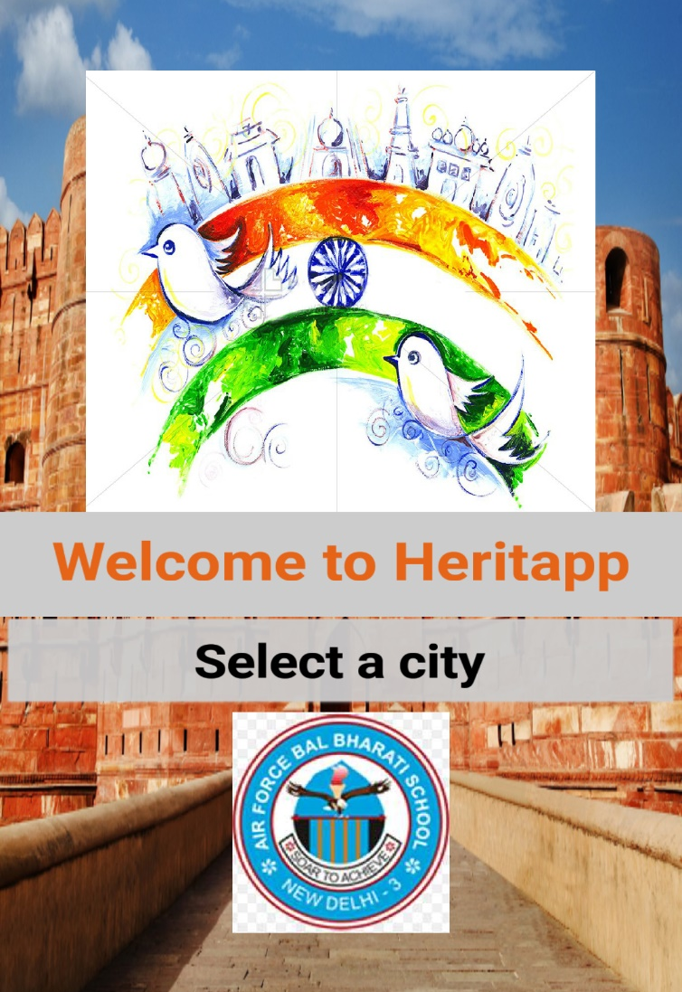
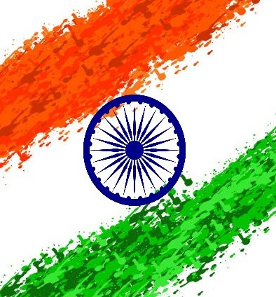
HACK OVERFLOW

Slide 2
Problem Statement
HOW CAN WE USE TECHNOLOGY TO HELP RESIDENTS & VISITORS CONNECT WITH THE HISTORY AND BUILT ENVIRONMENT OF INDIA?
These days people are forgetting about their culture and heritage.
They do not care about the history that resulted in how everything is now.
We want to help them realise the rich history and great heritage of our country

Slide 3
About the project
The project will aim at illustrating important historic events and monuments that stand in the purlieu of their area.
The user can select their desired city, doing which will display information on that particular city.
Additionally the user can navigate through the map provided at the end of page to check the location or other places or interest nearby.

Slide 4
Target Audience
Local Residents: Local inhabitants will be keen to know more about their local heritage, which will be just a heri-tap away. This app will be an extremely useful tool for them to learn more about their own home town.
Foreign and Domestic Tourists: Tourists will find this application to be extremely useful for sightseeing as well as learning about the local culture.
Students: This application can prove to be very handy for students wishing to learn about their local heritage, especially if they don’t have access to an internet connection.

Slide 5
Business Model
This app will be crowd sourced.
We have decided to keep this app as freeware.
It will allow users to find out more about their own heritage.
The data will be available offline, however for additional information users will require an internet connection.

Slide 6
Scopes of Improvement
The ways in which we believe the app can be improved are:
Making the app more Interactive and User Friendly
By making our interface more user-friendly and easier to navigate through
Adding more Cities and Information about them
Adding Additional information on already existing Cities (local cuisine, folklore, etc.) and Monuments
Improving multi-lingual support

Slide 7
Additional information
Project created by:
Aryan Madaan
Daksh Sansanwal
Sources:
whc.unesco.org
tourism.gov.in
en.wikipedia.org

